Slide 1
Improved Attacks for Characteristic-2 Parameters of the Cubic ABC Simple Matrix Encryption Scheme
Dustin Moody, *Ray Perlner, Daniel Smith-Tone

Slide 2
Our Contribution
Previous key recovery attacks on Ding’s simple matrix encryption scheme used a MinRank-like linear algebra search
  However, these attacks are less efficient for certain small characteristic fields
We use new techniques to improve attack complexity for key recovery on Ding’s simple matrix encryption scheme and its cubic variant
  Cubic
    Dramatic improvement for characteristic 2 parameters
    Small improvement for characteristic 3 parameters
  Quadratic
    Small improvement for characteristic 2 parameters
  Attack complexity is now (nearly) identical for all field characteristics

Slide 3
Outline
Multivariate Cryptography
Cubic/Quadratic ABC
Band Spaces and Band Kernels
Attack with the Discrete Differential
Using the Formal Derivative instead
Conclusion

Slide 4
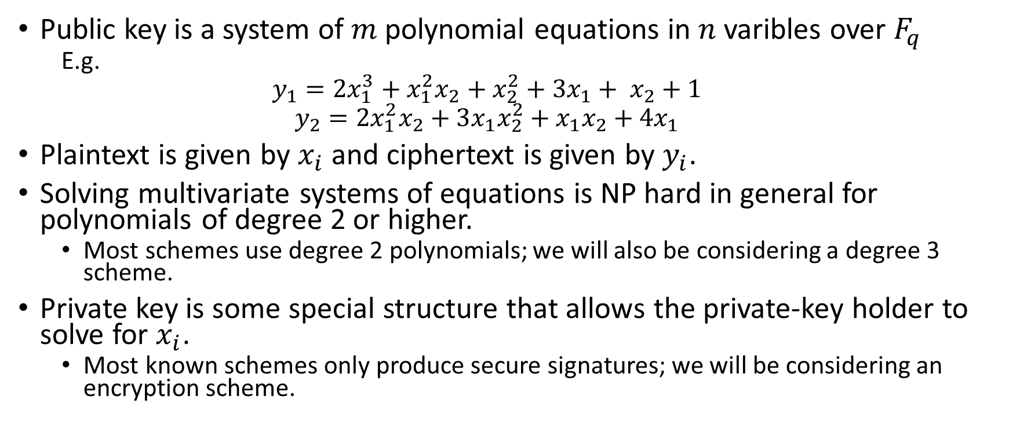
Multivariate cryptography
Public key is a system of $m$ polynomial equations in $n$ varibles over $F_{q}$
  E.g.
  $$y_{1}=2x_{1}^{3}+x_{1}^{2}x_{2}+x_{2}^{2}+3x_{1}+ x_{2}+1$$
  $$y_{2}=2x_{1}^{2}x_{2}+3x_{1}x_{2}^{2}+x_{1}x_{2}+4x_{1}$$
Plaintext is given by $x_{i}$ and ciphertext is given by $y_{i}$.
Solving multivariate systems of equations is NP hard in general for polynomials of degree 2 or higher.
  Most schemes use degree 2 polynomials; we will also be considering a degree 3 scheme.
Private key is some special structure that allows the private-key holder to solve for $x_{i}$.
  Most known schemes only produce secure signatures; we will be considering an encryption scheme.

Slide 5
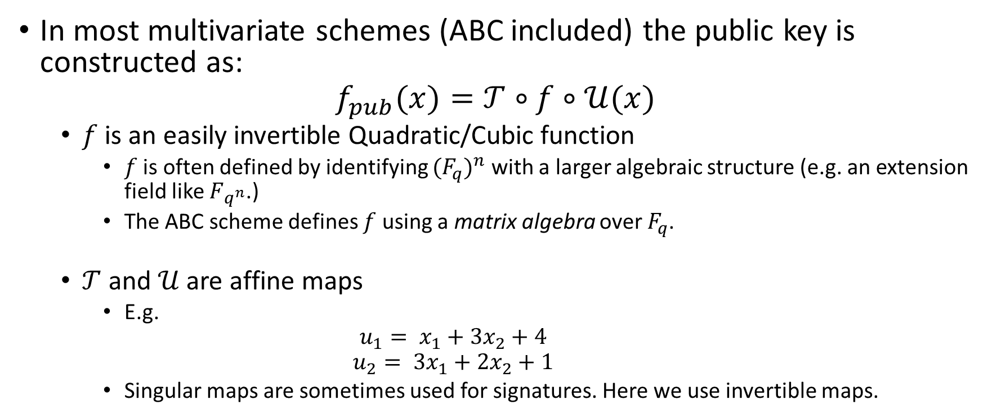
Multivariate Cryptography 2
Butterfly Construction
In most multivariate schemes (ABC included) the public key is constructed as:
$$f_{pub}(x)=𝒯∘f∘𝒰(x)$$
  $f$ is an easily invertible Quadratic/Cubic function
    $f$ is often defined by identifying ${(F_{q})}^{n}$ with a larger algebraic structure (e.g. an extension field like $F_{q^{n}}$.)
    The ABC scheme defines $f$ using a matrix algebra over $F_{q}$.
  $𝒯$ and $𝒰$ are affine maps
    E.g.
    $$u_{1}= x_{1}+3x_{2}+4$$
    $$u_{2}= {3x}_{1}+2x_{2}+1$$
    Singular maps are sometimes used for signatures. Here we use invertible maps.

Slide 6
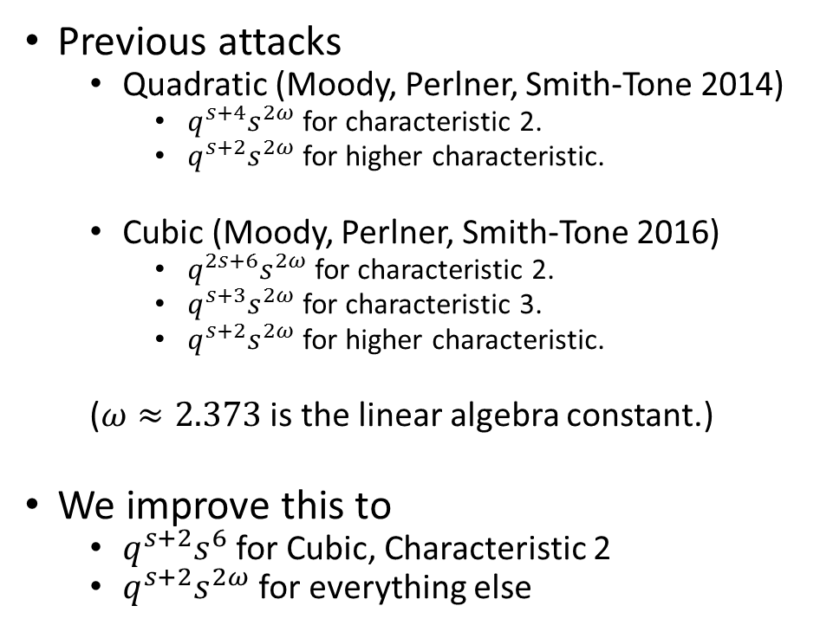
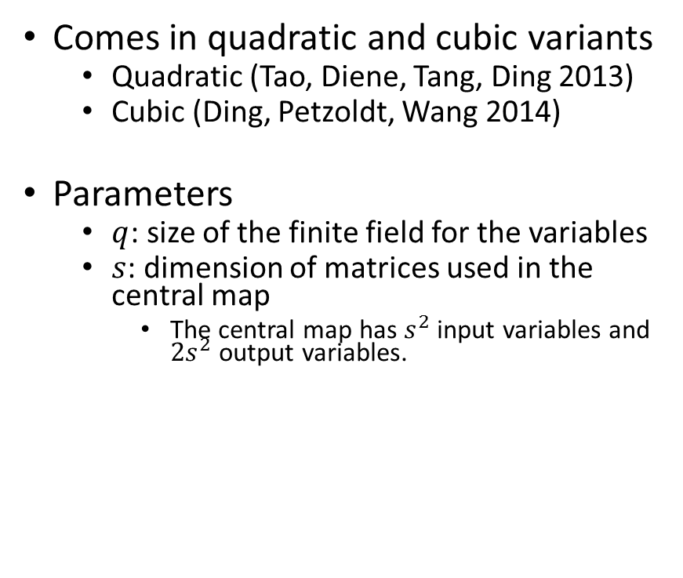
The ABC Cryptosystem
Comes in quadratic and cubic variants
  Quadratic (Tao, Diene, Tang, Ding 2013)
  Cubic (Ding, Petzoldt, Wang 2014)
Parameters
  $q$: size of the finite field for the variables
  $s$: dimension of matrices used in the central map
    The central map has $s^{2}$ input variables and ${2s}^{2}$ output variables.
Previous attacks
  Quadratic (Moody, Perlner, Smith-Tone 2014)
    $q^{s+4}s^{2ω}$ for characteristic 2.
    $q^{s+2}s^{2ω}$ for higher characteristic.
  Cubic (Moody, Perlner, Smith-Tone 2016)
    $q^{2s+6}s^{2ω}$ for characteristic 2.
    $q^{s+3}s^{2ω}$ for characteristic 3.
    $q^{s+2}s^{2ω}$ for higher characteristic.
  ($ω≈2.373$ is the linear algebra constant.)
We improve this to
  $q^{s+2}s^{6}$ for Cubic, Characteristic 2
  $q^{s+2}s^{2ω}$ for everything else

Slide 7

Quadratic ABC: The Core Map
Central map is $s^{2}→2s^{2}$ function where the equations are grouped as the elements of two matrices $f\left(\vec{x}\right)=\left(E_{1}\left(\vec{x}\right), E_{2}\left(\vec{x}\right)\right)$
  $$E_{1}=AB; E_{2}=AC$$
  $b_{i}$,$c_{i}$ are linear functions of $\vec{x}$.
  $p_{i}=x_{i}$.
Decryption proceeds by solving:
${(A(\vec{x}))}^{−1}E_{1}=B\left(\vec{x}\right)$
${(A(\vec{x}))}^{−1}E_{2}=C\left(\vec{x}\right)$
for ${(A(\vec{x}))}^{−1}$ and $\vec{x}$. (Linear)

Slide 8

Cubic ABC: The Core Map
Central map is $s^{2}→2s^{2}$ function where the equations are grouped as the elements of two matrices $f\left(\vec{x}\right)=\left(E_{1}\left(\vec{x}\right), E_{2}\left(\vec{x}\right)\right)$
  $$E_{1}=AB; E_{2}=AC$$
  $b_{i}$,$c_{i}$ are linear functions of $\vec{x}$.
  $p_{i}$ are quadratic functions of $\vec{x}$.
Decryption proceeds by solving:
${(A(\vec{x}))}^{−1}E_{1}=B\left(\vec{x}\right)$
${(A(\vec{x}))}^{−1}E_{2}=C\left(\vec{x}\right)$
for ${(A(\vec{x}))}^{−1}$ and $\vec{x}$. (Linear)

Slide 9
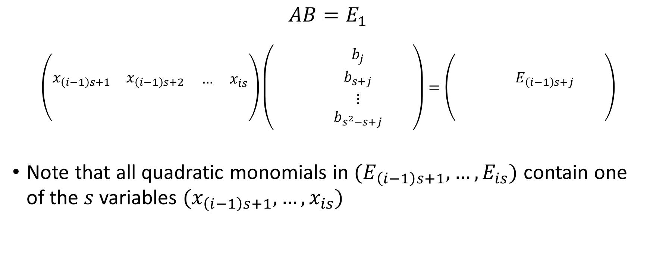
Special structure of Quadratic ABC
(Row Band Spaces)
$$AB=E_{1}$$
$$\left(\begin{matrix}\begin{matrix} & \\ x_{\left(i−1\right)s+1} & x_{\left(i−1\right)s+2}\end{matrix} & \begin{matrix} & \\ … & x_{is}\end{matrix} \\ \begin{matrix} & \\ & \end{matrix} & \begin{matrix} & \\ & \end{matrix}\end{matrix}\right)\left(\begin{matrix}\begin{matrix} & \\ & \end{matrix} & \begin{matrix}b_{j} & \\ b_{s+j} & \end{matrix} \\ \begin{matrix} & \\ & \end{matrix} & \begin{matrix}⋮ & \\ b_{s^{2}−s+j} & \end{matrix}\end{matrix}\right)=\left(\begin{matrix}\begin{matrix} & \\ & \end{matrix} & \begin{matrix} & \\ E_{\left(i−1\right)s+j} & \end{matrix} \\ \begin{matrix} & \\ & \end{matrix} & \begin{matrix} & \\ & \end{matrix}\end{matrix}\right)$$
Note that all quadratic monomials in $(E_{\left(i−1\right)s+1}, …, E_{is})$ contain one of the $s$ variables $(x_{\left(i−1\right)s+1}, …, x_{is})$

Slide 10
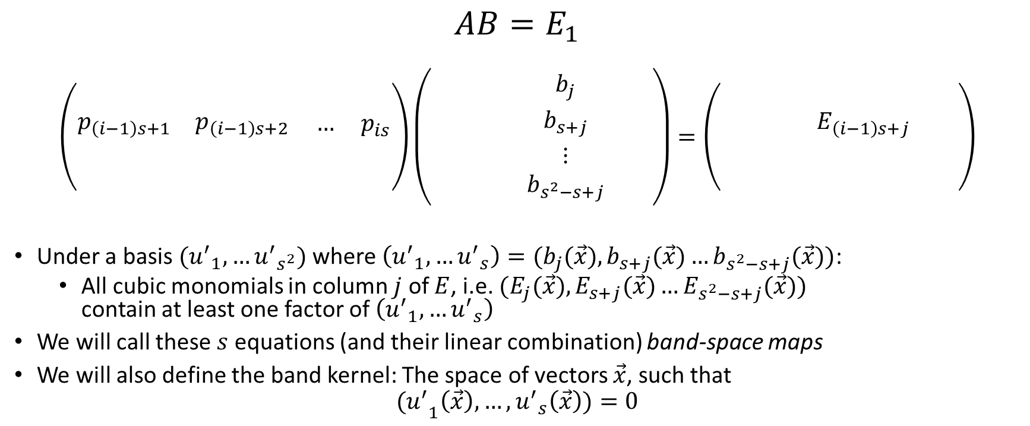
Special Structure of Cubic (and Quadratic) ABC
(Column Band Spaces)
$$AB=E_{1}$$
$$\left(\begin{matrix}\begin{matrix} & \\ p_{\left(i−1\right)s+1} & p_{\left(i−1\right)s+2}\end{matrix} & \begin{matrix} & \\ … & p_{is}\end{matrix} \\ \begin{matrix} & \\ & \end{matrix} & \begin{matrix} & \\ & \end{matrix}\end{matrix}\right)\left(\begin{matrix}\begin{matrix} & \\ & \end{matrix} & \begin{matrix}b_{j} & \\ b_{s+j} & \end{matrix} \\ \begin{matrix} & \\ & \end{matrix} & \begin{matrix}⋮ & \\ b_{s^{2}−s+j} & \end{matrix}\end{matrix}\right)=\left(\begin{matrix}\begin{matrix} & \\ & \end{matrix} & \begin{matrix} & \\ E_{\left(i−1\right)s+j} & \end{matrix} \\ \begin{matrix} & \\ & \end{matrix} & \begin{matrix} & \\ & \end{matrix}\end{matrix}\right)$$
Under a basis $({u^{′}}_{1}, …{u^{′}}_{s^{2}})$ where $\left({u^{′}}_{1}, …{u^{′}}_{s}\right)=(b_{j}(\vec{x}),b_{s+j}(\vec{x})…b_{s^{2}−s+j}(\vec{x}))$:
  All cubic monomials in column $j$ of $E$, i.e. $(E_{j}(\vec{x}),E_{s+j}(\vec{x})…E_{s^{2}−s+j}(\vec{x}))$ contain at least one factor of $\left({u^{′}}_{1}, …{u^{′}}_{s}\right)$
We will call these $s$ equations (and their linear combination) band-space maps
We will also define the band kernel: The space of vectors $\vec{x}$, such that
$${(u^{′}}_{1}\left(\vec{x}\right),…,{u^{′}}_{s}\left(\vec{x}\right))=0$$

Slide 11

How many band spaces are there:
Not only do the columns of $E_{1}=AB$ and $E_{2}=AC$ define band spaces, but fixed linear combinations of the columns $(\vec{β},\vec{γ})$ do as well.
  Band Space:
  Band Kernel:
  ($x∈{ℬ𝒦}_{β,γ}$)

Slide 12
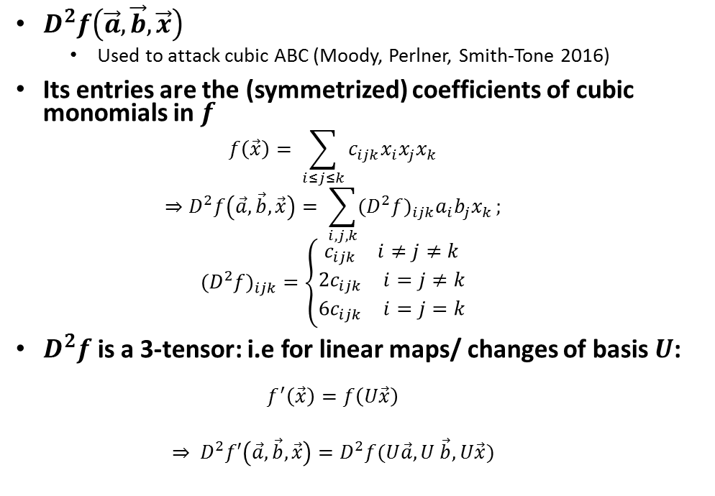
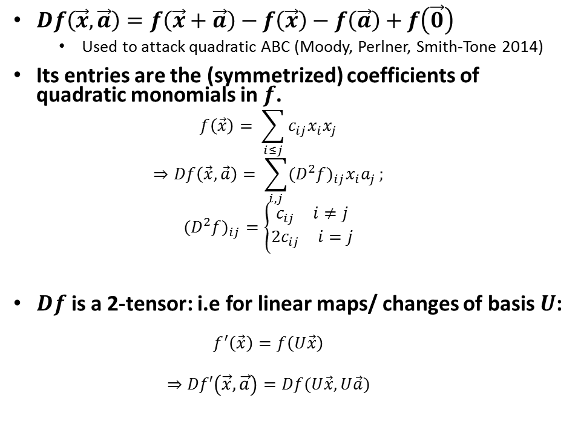
The Discrete Differential
First Differential
Second Differential
$Df\left(\vec{x},\vec{a}\right)=f\left(\vec{x}+\vec{a}\right)−f\left(\vec{x}\right)−f\left(\vec{a}\right)+f\left(\vec{0}\right)$
  Used to attack quadratic ABC (Moody, Perlner, Smith-Tone 2014)
Its entries are the (symmetrized) coefficients of quadratic monomials in $f$.
  $$f\left(\vec{x}\right)= \sum_{i≤j}{c_{ij}x_{i}x_{j}}$$
  $$⇒Df\left(\vec{x},\vec{a}\right)= \sum_{i,j}{({D^{2}f)}_{ij}x_{i}a_{j}};$$
  $${{(D}^{2}f)}_{ij}=\left\{\begin{matrix}\begin{matrix}c_{ij} & i≠j\end{matrix} \\ \begin{matrix}{2c}_{ij} & i=j\end{matrix}\end{matrix}\right.$$
$Df$ is a 2-tensor: i.e for linear maps/ changes of basis $U$:
  $$f^{′}\left(\vec{x}\right)=f\left(U\vec{x}\right)$$
  $$⇒Df′\left(\vec{x},\vec{a}\right)=Df(U\vec{x},U\vec{a})$$
$D^{2}f\left(\vec{a},\vec{b},\vec{x}\right)$
  Used to attack cubic ABC (Moody, Perlner, Smith-Tone 2016)
Its entries are the (symmetrized) coefficients of cubic monomials in $f$
  $$f\left(\vec{x}\right)= \sum_{i≤j≤k}{c_{ijk}x_{i}x_{j}x_{k}}$$
  $$⇒D^{2}f\left(\vec{a},\vec{b},\vec{x}\right)= \sum_{i,j,k}{({D^{2}f)}_{ijk}a_{i}b_{j}x_{k}};$$
  $${{(D}^{2}f)}_{ijk}=\left\{\begin{matrix}\begin{matrix}c_{ijk} & i≠j≠k\end{matrix} \\ \begin{matrix}{2c}_{ijk} & i=j≠k\end{matrix} \\ \begin{matrix}{6c}_{ijk} & i=j=k\end{matrix}\end{matrix}\right.$$
$D^{2}f$ is a 3-tensor: i.e for linear maps/ changes of basis $U$:
  $$f^{′}\left(\vec{x}\right)=f\left(U\vec{x}\right)$$
  $$⇒ D^{2}f′\left(\vec{a},\vec{b},\vec{x}\right)=D^{2}f(U\vec{a},U \vec{b}, U\vec{x})$$

Slide 13

The Differential Form of Band-Space Maps
(${u′}_{i}$ basis)
Quadratic
Cubic

Slide 14


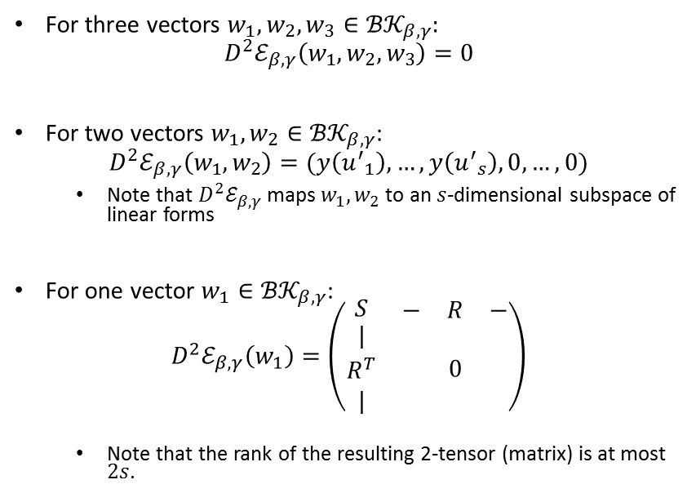

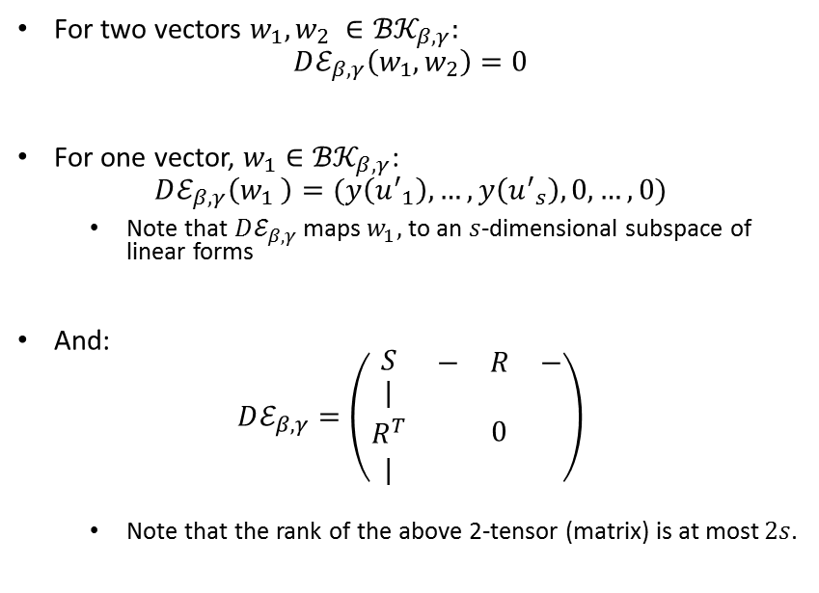
Useful Facts about Band Space Differentials
(in the ${u′}_{i}$ basis)
Quadratic ($D𝓔_{β,γ}$)
Cubic($D^{2}𝓔_{β,γ}$)
For two vectors $w_{1}, w_{2} ∈{ℬ𝒦}_{β,γ}$:
$$Dℰ_{β,γ}\left(w_{1},w_{2}\right)=0$$
For one vector, $w_{1}∈{ℬ𝒦}_{β,γ}$:
$$Dℰ_{β,γ}\left(w_{1} \right)=(y\left({u^{′}}_{1}\right), …,y\left({u^{′}}_{s}\right),0,…,0)$$
  Note that $Dℰ_{β,γ}$ maps $w_{1},$to an $s$-dimensional subspace of linear forms
And:
$$Dℰ_{β,γ}=\left(\begin{matrix}S & \begin{matrix}− & R & −\end{matrix} \\ \begin{matrix}| \\ R^{T} \\ |\end{matrix} & 0\end{matrix}\right)$$
  Note that the rank of the above 2-tensor (matrix) is at most $2s$.
For three vectors $w_{1}, w_{2},w_{3}∈{ℬ𝒦}_{β,γ}$:
$$D^{2}ℰ_{β,γ}\left(w_{1},w_{2},w_{3}\right)=0$$
For two vectors $w_{1}, w_{2}∈{ℬ𝒦}_{β,γ}$:
$$D^{2}ℰ_{β,γ}\left(w_{1},w_{2}\right)=(y\left({u^{′}}_{1}\right), …,y\left({u^{′}}_{s}\right),0,…,0)$$
  Note that $D^{2}ℰ_{β,γ}$ maps $w_{1}, w_{2}$ to an $s$-dimensional subspace of linear forms
For one vector $w_{1}∈{ℬ𝒦}_{β,γ}$:
$$D^{2}ℰ_{β,γ}\left(w_{1}\right)=\left(\begin{matrix}S & \begin{matrix}− & R & −\end{matrix} \\ \begin{matrix}| \\ R^{T} \\ |\end{matrix} & 0\end{matrix}\right)$$
  Note that the rank of the resulting 2-tensor (matrix) is at most $2s$.

Slide 15
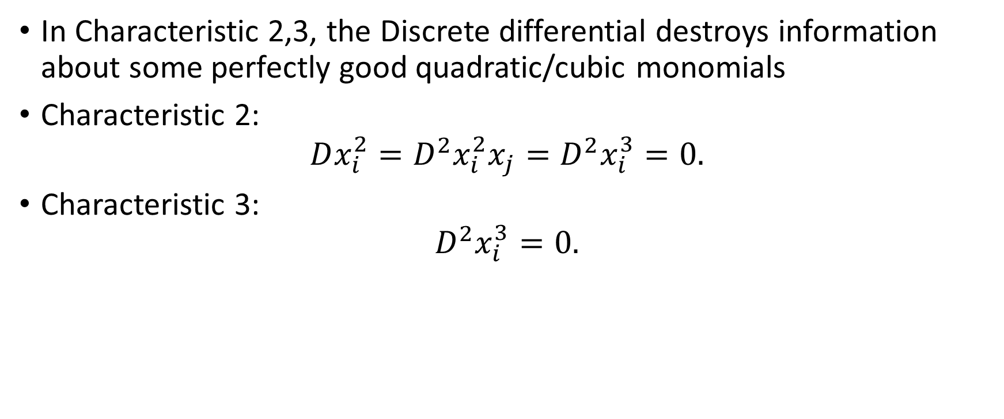
What’s wrong with the Discrete differential?
In Characteristic 2,3, the Discrete differential destroys information about some perfectly good quadratic/cubic monomials
Characteristic 2:
$$Dx_{i}^{2}=D^{2}x_{i}^{2}x_{j}=D^{2}x_{i}^{3}=0.$$
Characteristic 3:
$$D^{2}x_{i}^{3}=0.$$

Slide 16
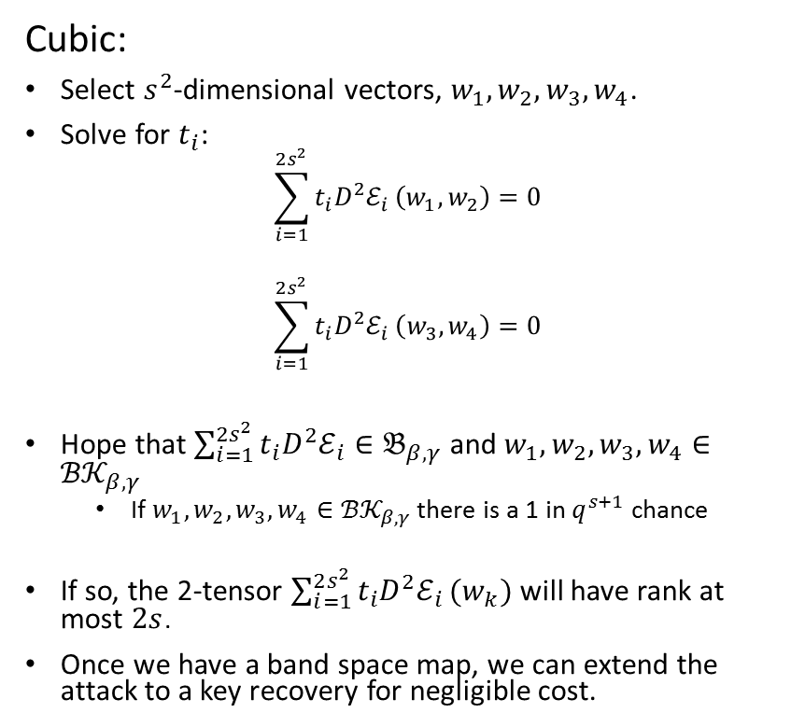
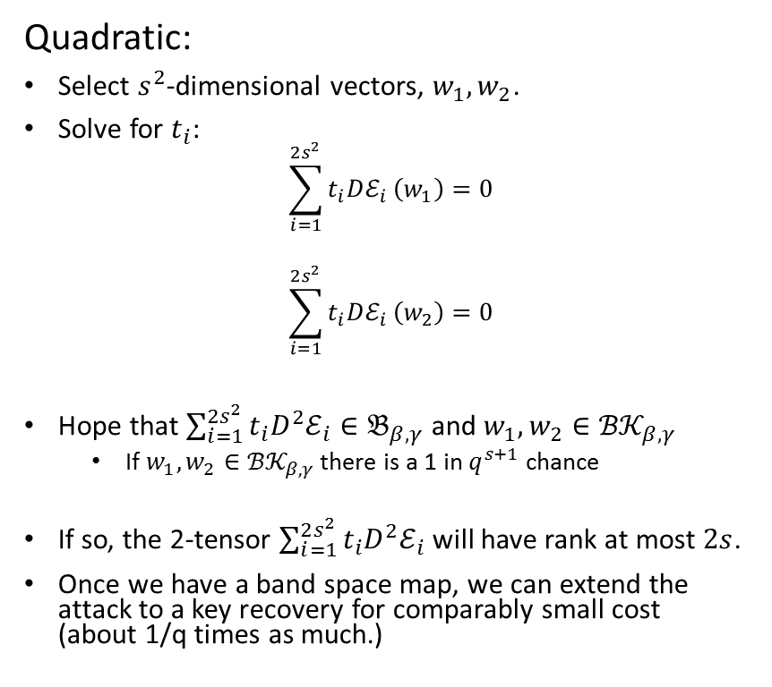
How Does This Play Out in Attacks?:
Overall Strategy
Quadratic:
Select $s^{2}$-dimensional vectors, $w_{1},w_{2}$.
Solve for $t_{i}$:
$$\sum_{i=1}^{2s^{2}}{t_{i}Dℰ_{i}}\left(w_{1}\right)=0$$
$$\sum_{i=1}^{2s^{2}}{t_{i}Dℰ_{i}}\left(w_{2}\right)=0$$
Hope that $\sum_{i=1}^{2s^{2}}{t_{i}D^{2}ℰ_{i}}∈𝔅_{β,γ}$ and $w_{1},w_{2}∈{ℬ𝒦}_{β,γ}$
  If $w_{1},w_{2}∈{ℬ𝒦}_{β,γ}$ there is a 1 in $q^{s+1}$ chance
If so, the 2-tensor $\sum_{i=1}^{2s^{2}}{t_{i}D^{2}ℰ_{i}}$ will have rank at most $2s$.
Once we have a band space map, we can extend the attack to a key recovery for comparably small cost (about 1/q times as much.)
Cubic:
Select $s^{2}$-dimensional vectors, $w_{1},w_{2},w_{3},w_{4}$.
Solve for $t_{i}$:
$$\sum_{i=1}^{2s^{2}}{t_{i}D^{2}ℰ_{i}}\left(w_{1},w_{2}\right)=0$$
$$\sum_{i=1}^{2s^{2}}{t_{i}D^{2}ℰ_{i}}\left(w_{3},w_{4}\right)=0$$
Hope that $\sum_{i=1}^{2s^{2}}{t_{i}D^{2}ℰ_{i}}∈𝔅_{β,γ}$ and $w_{1},w_{2},w_{3},w_{4}∈{ℬ𝒦}_{β,γ}$
  If $w_{1},w_{2},w_{3},w_{4}∈{ℬ𝒦}_{β,γ}$ there is a 1 in $q^{s+1}$ chance
If so, the 2-tensor $\sum_{i=1}^{2s^{2}}{t_{i}D^{2}ℰ_{i}}(w_{k})$ will have rank at most $2s$.
Once we have a band space map, we can extend the attack to a key recovery for negligible cost.

Slide 17
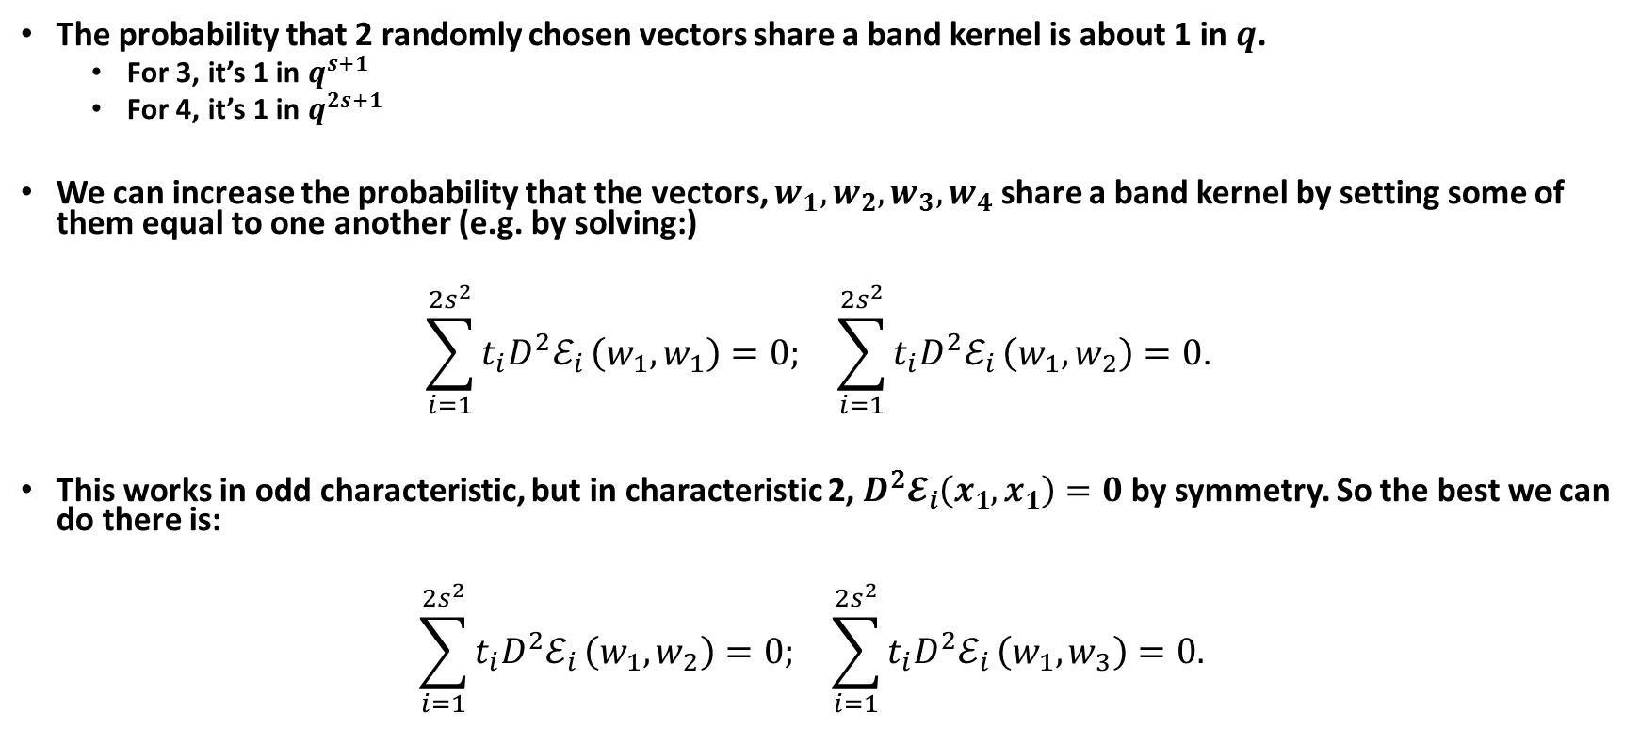
How Does This Play Out in Attacks?:
Setting Some Vectors Equal (Cubic Case)
The probability that 2 randomly chosen vectors share a band kernel is about 1 in $q$.
  For 3, it’s 1 in $q^{s+1}$
  For 4, it’s 1 in $q^{2s+1}$
We can increase the probability that the vectors, $w_{1},w_{2},w_{3},w_{4}$ share a band kernel by setting some of them equal to one another (e.g. by solving:)
$$\begin{matrix}\sum_{i=1}^{2s^{2}}{t_{i}D^{2}ℰ_{i}}\left(w_{1},w_{1}\right)=0; & \sum_{i=1}^{2s^{2}}{t_{i}D^{2}ℰ_{i}}\left(w_{1},w_{2}\right)=0\text{.}\end{matrix}$$
This works in odd characteristic, but in characteristic 2, $D^{2}𝓔_{i}\left(x_{1},x_{1}\right)=0$ by symmetry. So the best we can do there is:
$$\begin{matrix}\sum_{i=1}^{2s^{2}}{t_{i}D^{2}ℰ_{i}}\left(w_{1},w_{2}\right)=0; & \sum_{i=1}^{2s^{2}}{t_{i}D^{2}ℰ_{i}}\left(w_{1},w_{3}\right)=0. \end{matrix}$$

Slide 18
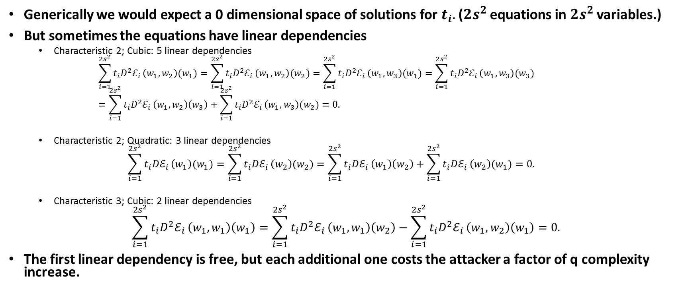
How Does This Play Out in Attacks?:
Searching Through a Large Solution Space
Generically we would expect a 0 dimensional space of solutions for $t_{i}.$ ($2s^{2}$ equations in $2s^{2}$ variables.)
But sometimes the equations have linear dependencies
  Characteristic 2; Cubic: 5 linear dependencies
    $$\sum_{i=1}^{2s^{2}}{t_{i}D^{2}ℰ_{i}}\left(w_{1},w_{2}\right)(w_{1})=\sum_{i=1}^{2s^{2}}{t_{i}D^{2}ℰ_{i}}\left(w_{1},w_{2}\right)(w_{2})=\sum_{i=1}^{2s^{2}}{t_{i}D^{2}ℰ_{i}}\left(w_{1},w_{3}\right)(w_{1})=\sum_{i=1}^{2s^{2}}{t_{i}D^{2}ℰ_{i}}\left(w_{1},w_{3}\right)(w_{3})=\sum_{i=1}^{2s^{2}}{t_{i}D^{2}ℰ_{i}}\left(w_{1},w_{2}\right)\left(w_{3}\right)+\sum_{i=1}^{2s^{2}}{t_{i}D^{2}ℰ_{i}}\left(w_{1},w_{3}\right)(w_{2})=0.$$
  Characteristic 2; Quadratic: 3 linear dependencies
  $$\sum_{i=1}^{2s^{2}}{t_{i}Dℰ_{i}}\left(w_{1}\right)(w_{1})=\sum_{i=1}^{2s^{2}}{t_{i}Dℰ_{i}}\left(w_{2}\right)(w_{2})=\sum_{i=1}^{2s^{2}}{t_{i}Dℰ_{i}}\left(w_{1}\right)\left(w_{2}\right)+\sum_{i=1}^{2s^{2}}{t_{i}Dℰ_{i}}\left(w_{2}\right)(w_{1})=0.$$
  Characteristic 3; Cubic: 2 linear dependencies
$$\sum_{i=1}^{2s^{2}}{t_{i}D^{2}ℰ_{i}}\left(w_{1},w_{1}\right)\left(w_{1}\right)=\sum_{i=1}^{2s^{2}}{t_{i}D^{2}ℰ_{i}}\left(w_{1},w_{1}\right)\left(w_{2}\right)−\sum_{i=1}^{2s^{2}}{t_{i}D^{2}ℰ_{i}}\left(w_{1},w_{2}\right)\left(w_{1}\right)=0.$$
The first linear dependency is free, but each additional one costs the attacker a factor of q complexity increase.

Slide 19
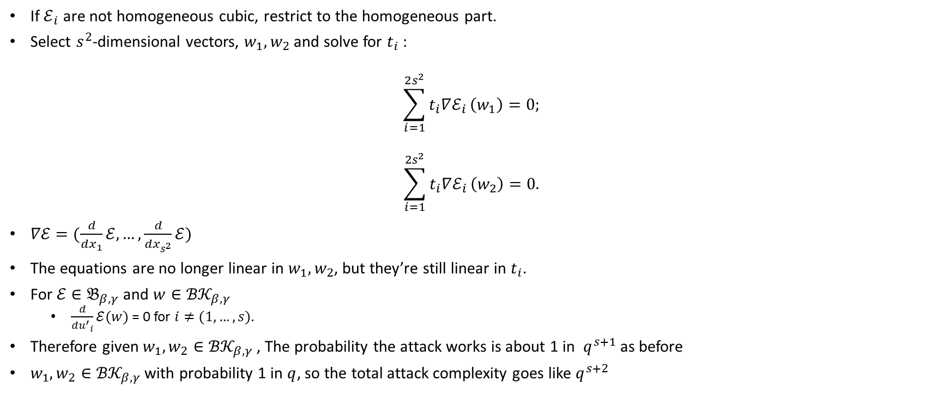
New Attack Strategy (Cubic Case):
Use the Formal Derivative
If $ℰ_{i}$ are not homogeneous cubic, restrict to the homogeneous part.
Select $s^{2}$-dimensional vectors, $w_{1},w_{2}$ and solve for $t_{i}$ :
$$\sum_{i=1}^{2s^{2}}{t_{i}∇ℰ_{i}}\left(w_{1}\right)=0;$$
$$\sum_{i=1}^{2s^{2}}{t_{i}∇ℰ_{i}}\left(w_{2}\right)=0.$$
$∇ℰ=(\frac{d}{dx_{1}}ℰ, …,\frac{d}{dx_{s^{2}}}ℰ)$
The equations are no longer linear in $w_{1},w_{2}$, but they’re still linear in $t_{i}$.
For$ℰ∈𝔅_{β,γ}$ and $w∈{ℬ𝒦}_{β,γ}$
  $\frac{d}{d{u^{′}}_{i}}ℰ(w)$ = 0 for $i≠(1,…,s)$.
Therefore given $w_{1},w_{2}∈{ℬ𝒦}_{β,γ}$ , The probability the attack works is about 1 in $q^{s+1}$ as before
$w_{1},w_{2}∈{ℬ𝒦}_{β,γ}$ with probability 1 in $q$, so the total attack complexity goes like $q^{s+2}$

Slide 20
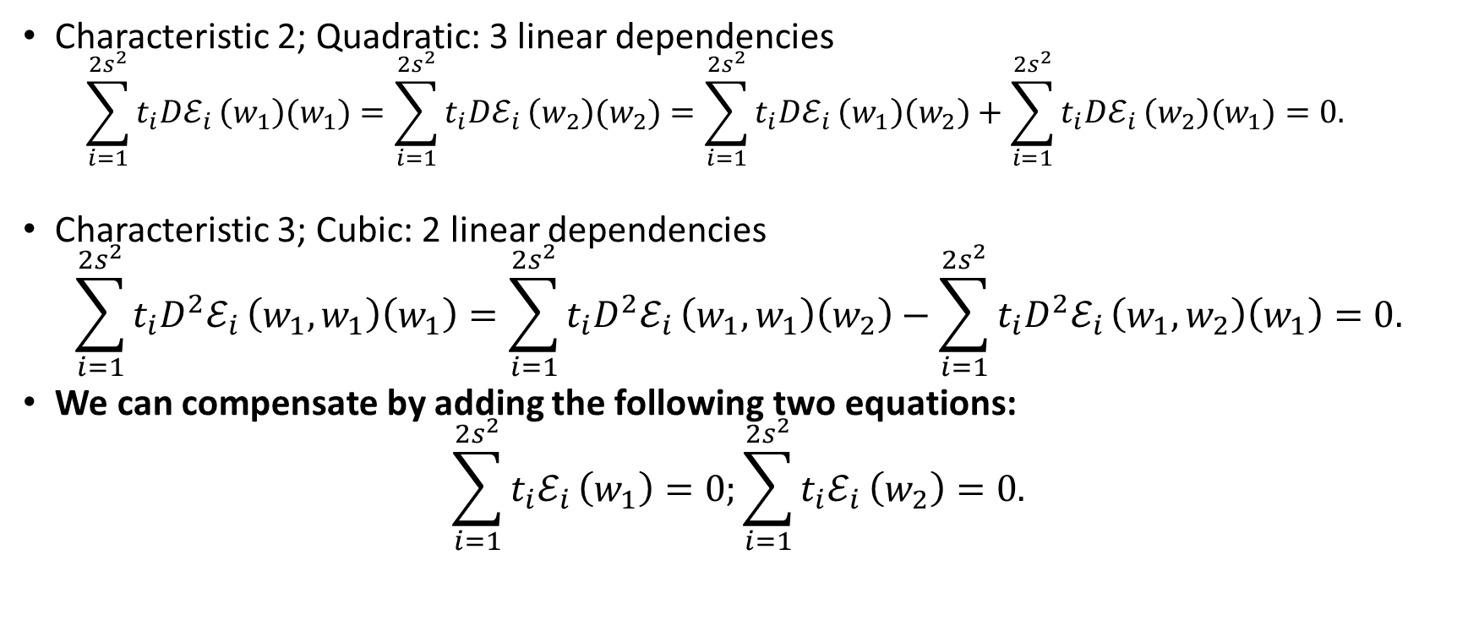
Compensating for Linear Dependencies
Characteristic 2; Quadratic: 3 linear dependencies
  $$\sum_{i=1}^{2s^{2}}{t_{i}Dℰ_{i}}\left(w_{1}\right)(w_{1})=\sum_{i=1}^{2s^{2}}{t_{i}Dℰ_{i}}\left(w_{2}\right)(w_{2})=\sum_{i=1}^{2s^{2}}{t_{i}Dℰ_{i}}\left(w_{1}\right)\left(w_{2}\right)+\sum_{i=1}^{2s^{2}}{t_{i}Dℰ_{i}}\left(w_{2}\right)(w_{1})=0.$$
Characteristic 3; Cubic: 2 linear dependencies
$$\sum_{i=1}^{2s^{2}}{t_{i}D^{2}ℰ_{i}}\left(w_{1},w_{1}\right)\left(w_{1}\right)=\sum_{i=1}^{2s^{2}}{t_{i}D^{2}ℰ_{i}}\left(w_{1},w_{1}\right)\left(w_{2}\right)−\sum_{i=1}^{2s^{2}}{t_{i}D^{2}ℰ_{i}}\left(w_{1},w_{2}\right)\left(w_{1}\right)=0.$$
We can compensate by adding the following two equations:
$$\sum_{i=1}^{2s^{2}}{t_{i}ℰ_{i}}\left(w_{1}\right)=0;\sum_{i=1}^{2s^{2}}{t_{i}ℰ_{i}}\left(w_{2}\right)=0.$$

Slide 21
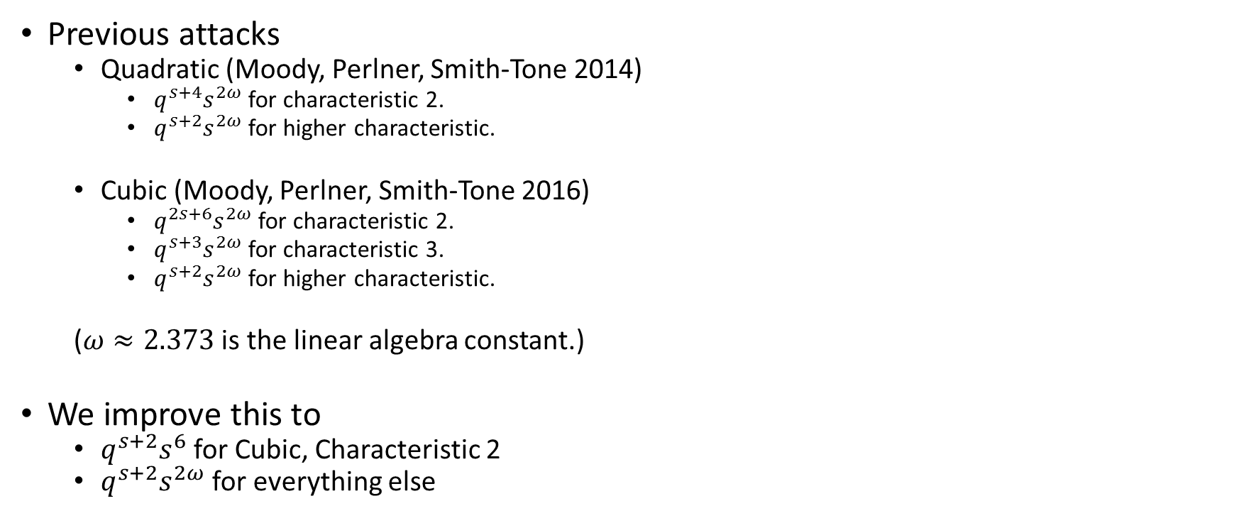
In Summary
Previous attacks
  Quadratic (Moody, Perlner, Smith-Tone 2014)
    $q^{s+4}s^{2ω}$ for characteristic 2.
    $q^{s+2}s^{2ω}$ for higher characteristic.
  Cubic (Moody, Perlner, Smith-Tone 2016)
    $q^{2s+6}s^{2ω}$ for characteristic 2.
    $q^{s+3}s^{2ω}$ for characteristic 3.
    $q^{s+2}s^{2ω}$ for higher characteristic.
  ($ω≈2.373$ is the linear algebra constant.)
We improve this to
  $q^{s+2}s^{6}$ for Cubic, Characteristic 2
  $q^{s+2}s^{2ω}$ for everything else

Slide 22
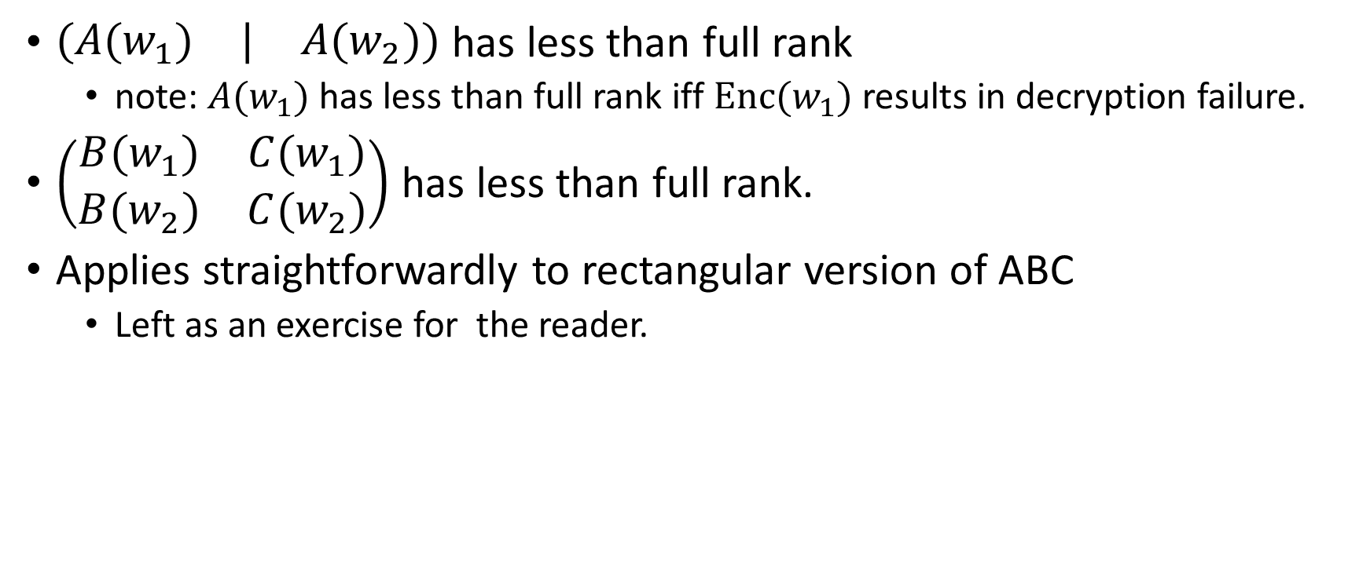
Succinct Conditions for Attack Success
$\left(\begin{matrix}A(w_{1}) & | & A(w_{2})\end{matrix}\right)$ has less than full rank
  note: $A(w_{1})$ has less than full rank iff $Enc(w_{1})$ results in decryption failure.
$\left(\begin{matrix}B(w_{1}) & C(w_{1}) \\ B(w_{2}) & C(w_{2})\end{matrix}\right)$ has less than full rank.
Applies straightforwardly to rectangular version of ABC
  Left as an exercise for the reader.

Slide 23
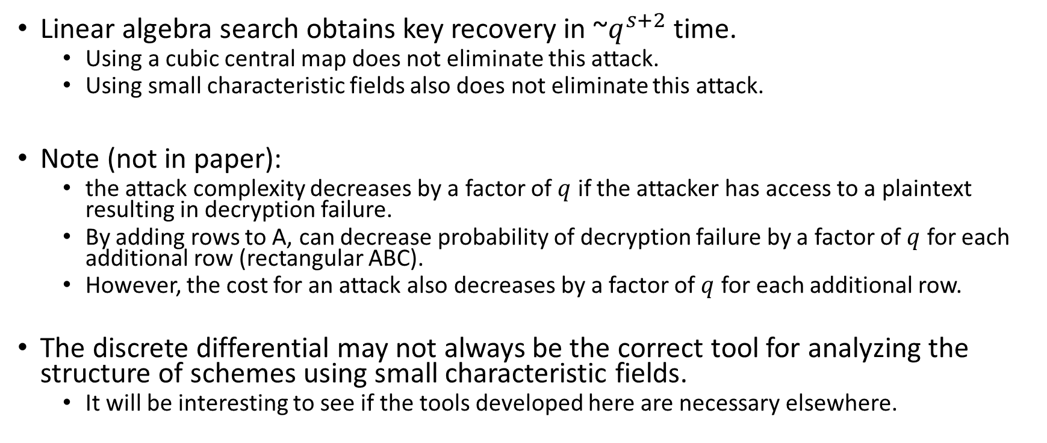
Conclusion
Linear algebra search obtains key recovery in ~$q^{s+2}$ time.
  Using a cubic central map does not eliminate this attack.
  Using small characteristic fields also does not eliminate this attack.
Note (not in paper):
  the attack complexity decreases by a factor of $q$ if the attacker has access to a plaintext resulting in decryption failure.
  By adding rows to A, can decrease probability of decryption failure by a factor of $q$ for each additional row (rectangular ABC).
  However, the cost for an attack also decreases by a factor of $q$ for each additional row.
The discrete differential may not always be the correct tool for analyzing the structure of schemes using small characteristic fields.
  It will be interesting to see if the tools developed here are necessary elsewhere.

Slide 24
Thank You!

Slide 25
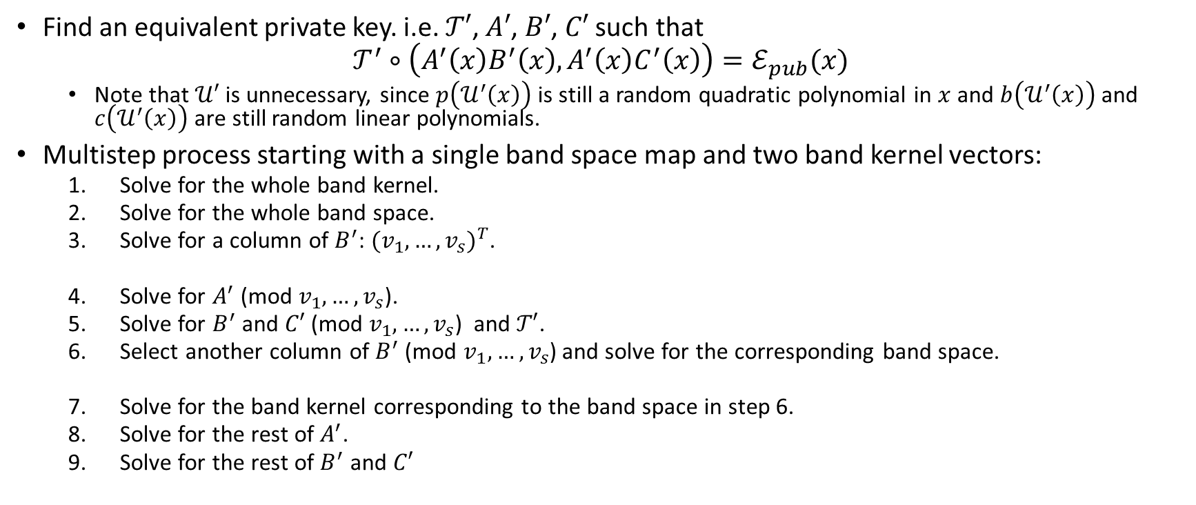
Key Recovery: Overall Strategy
Find an equivalent private key. i.e. $𝒯′$, $A′$, $B′$, $C′$ such that
$$𝒯^{′}∘\left(A^{′}\left(x\right)B^{′}\left(x\right), A^{′}\left(x\right)C^{′}\left(x\right)\right)=ℰ_{pub}(x)$$
  Note that $𝒰′$ is unnecessary, since $p\left(𝒰^{′}\left(x\right)\right)$ is still a random quadratic polynomial in $x$ and $b\left(𝒰^{′}\left(x\right)\right)$ and $c\left(𝒰^{′}\left(x\right)\right)$ are still random linear polynomials.
Multistep process starting with a single band space map and two band kernel vectors:
  Solve for the whole band kernel.
  Solve for the whole band space.
  Solve for a column of $B^{′}$: ${(v_{1},…,v_{s})}^{T}$.
  Solve for $A^{′}$ (mod $v_{1},…,v_{s}$).
  Solve for $B^{′}$ and $C′$ (mod $v_{1},…,v_{s}$) and $𝒯′$.
  Select another column of $B^{′}$ (mod $v_{1},…,v_{s}$) and solve for the corresponding band space.
  Solve for the band kernel corresponding to the band space in step 6.
  Solve for the rest of $A^{′}$.
  Solve for the rest of $B^{′}$ and $C′$

Slide 26
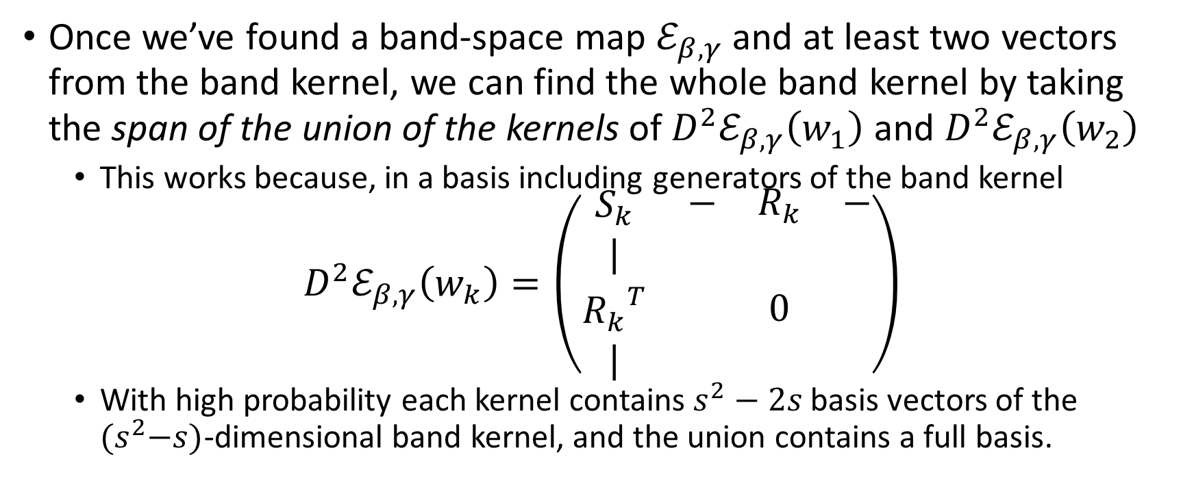
Key Recovery Step 1:
Solving for the whole band kernel.
Once we’ve found a band-space map $ℰ_{β,γ}$ and at least two vectors from the band kernel, we can find the whole band kernel by taking the span of the union of the kernels of $D^{2}ℰ_{β,γ}\left(w_{1}\right)$ and $D^{2}ℰ_{β,γ}\left(w_{2}\right)$
  This works because, in a basis including generators of the band kernel
$$D^{2}ℰ_{β,γ}\left(w_{k}\right)=\left(\begin{matrix}S_{k} & \begin{matrix}− & R_{k} & −\end{matrix} \\ \begin{matrix}| \\ {R_{k}}^{T} \\ |\end{matrix} & 0\end{matrix}\right)$$
  With high probability each kernel contains $s^{2}−2s$ basis vectors of the ${(s}^{2}−s)$-dimensional band kernel, and the union contains a full basis.

Slide 27
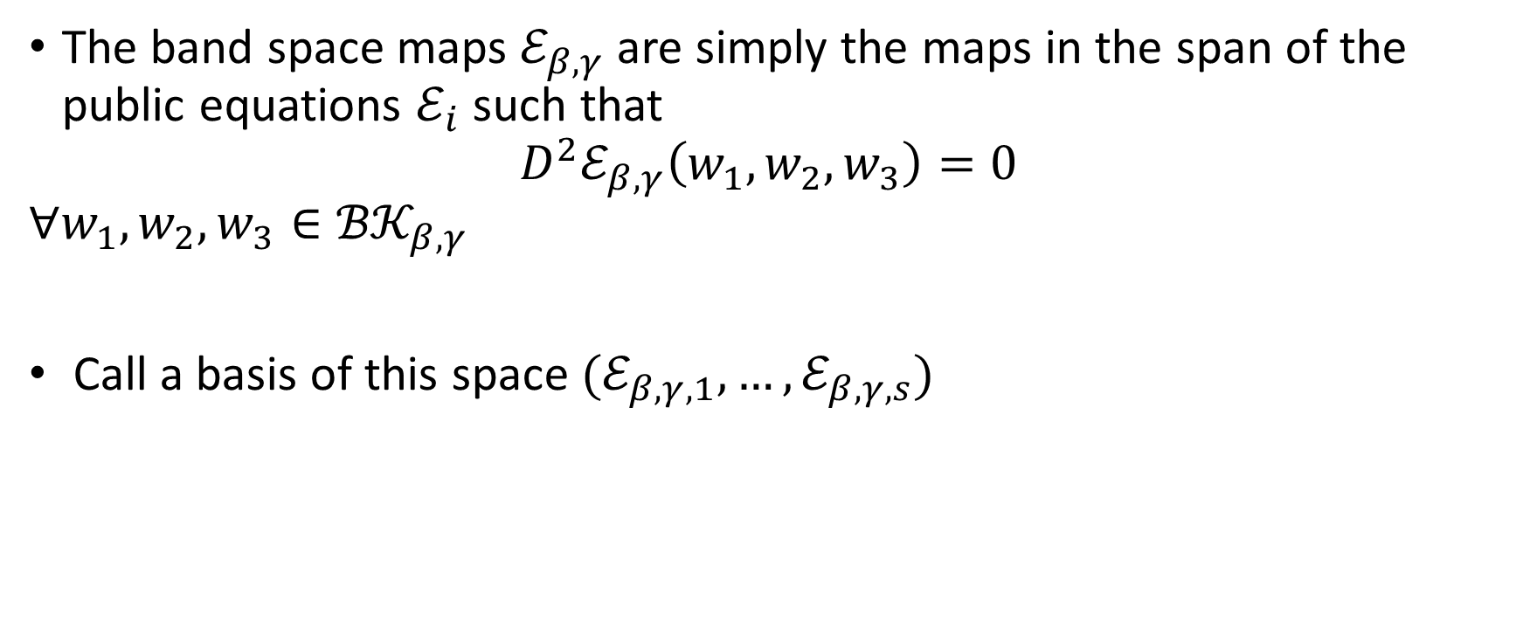
Key Recovery Step 2:
Solving for the whole band space
The band space maps $ℰ_{β,γ}$ are simply the maps in the span of the public equations $ℰ_{i}$ such that
$$D^{2}ℰ_{β,γ}\left(w_{1},w_{2},w_{3}\right)=0$$
$$∀w_{1}, w_{2},w_{3}∈{ℬ𝒦}_{β,γ}$$
Call a basis of this space $(ℰ_{β,γ,1},…,ℰ_{β,γ,s})$

Slide 28

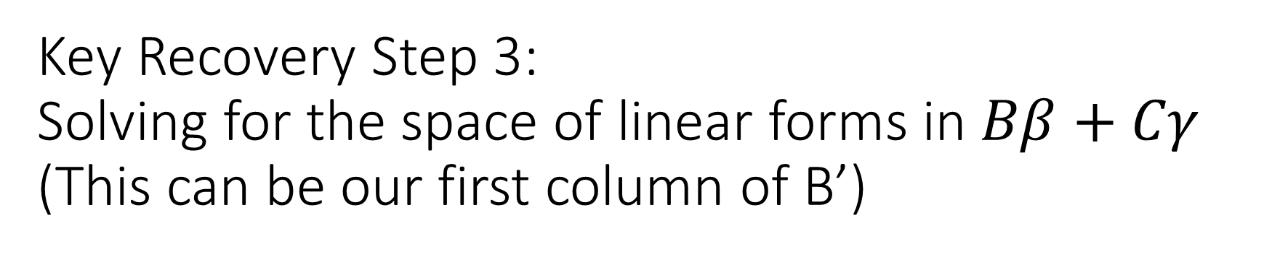
Key Recovery Step 3:
Solving for the space of linear forms in $Bβ+Cγ$
(This can be our first column of B’)
These are simply the space of linear forms $v$ such that
$$v(w)=0$$
$$∀w∈{ℬ𝒦}_{β,γ}$$
Call a basis of this space $(v_{1},…,v_{s})$

Slide 29
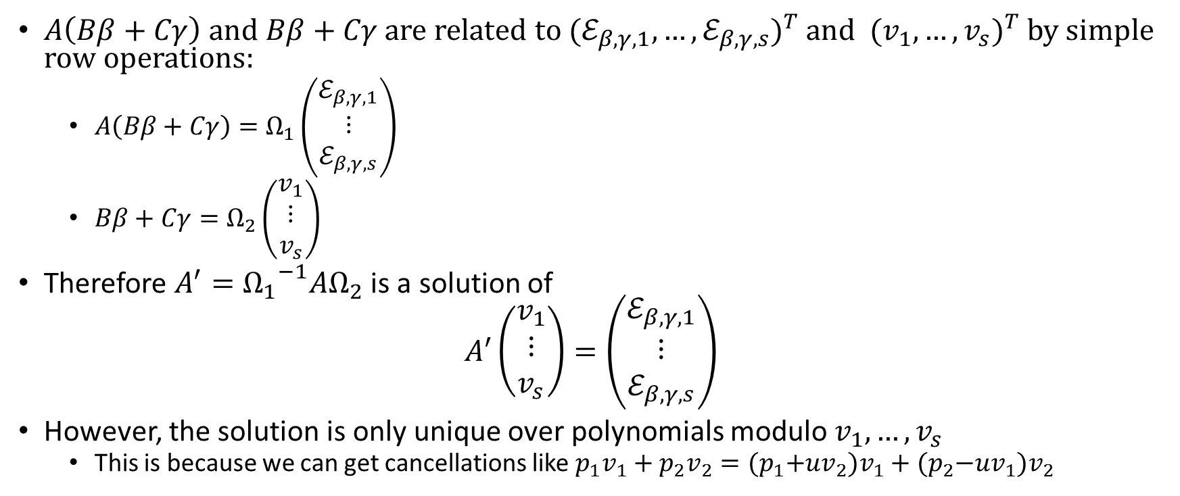

Key Recovery Step 4:
Solving for $A^{′}$ (mod $v_{1},…,v_{s}$)
$A\left(Bβ+Cγ\right)$ and $Bβ+Cγ$ are related to ${(ℰ_{β,γ,1},…,ℰ_{β,γ,s})}^{T}$ and ${(v_{1},…,v_{s})}^{T}$ by simple row operations:
  $A\left(Bβ+Cγ\right)=Ω_{1}\left(\begin{matrix}ℰ_{β,γ,1} \\ ⋮ \\ ℰ_{β,γ,s}\end{matrix}\right)$
  $Bβ+Cγ=Ω_{2}\left(\begin{matrix}v_{1} \\ ⋮ \\ v_{s}\end{matrix}\right)$
Therefore $A^{′}={Ω_{1}}^{−1}AΩ_{2}$ is a solution of
$$A′\left(\begin{matrix}v_{1} \\ ⋮ \\ v_{s}\end{matrix}\right)=\left(\begin{matrix}ℰ_{β,γ,1} \\ ⋮ \\ ℰ_{β,γ,s}\end{matrix}\right)$$
However, the solution is only unique over polynomials modulo $v_{1},…,v_{s}$
  This is because we can get cancellations like $p_{1}v_{1}+p_{2}v_{2}={(p}_{1}+uv_{2})v_{1}+{(p}_{2}−uv_{1})v_{2}$

Slide 30
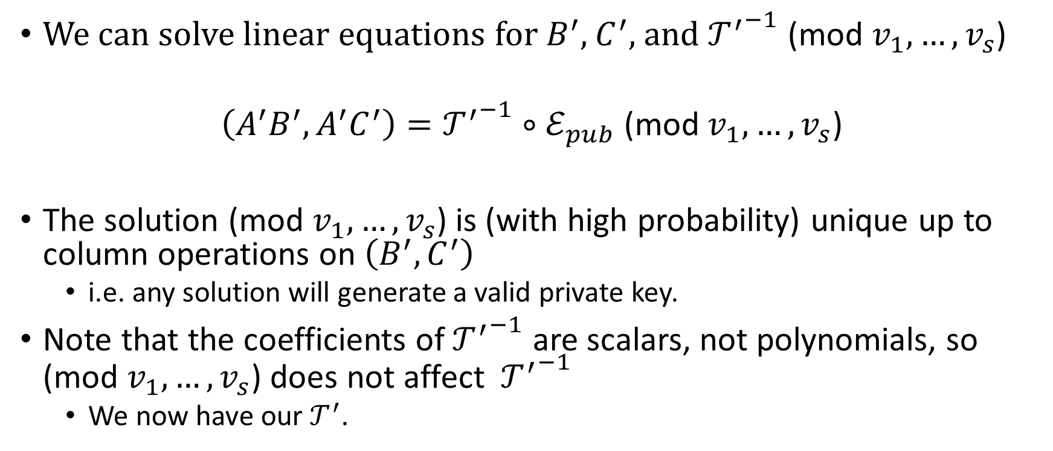
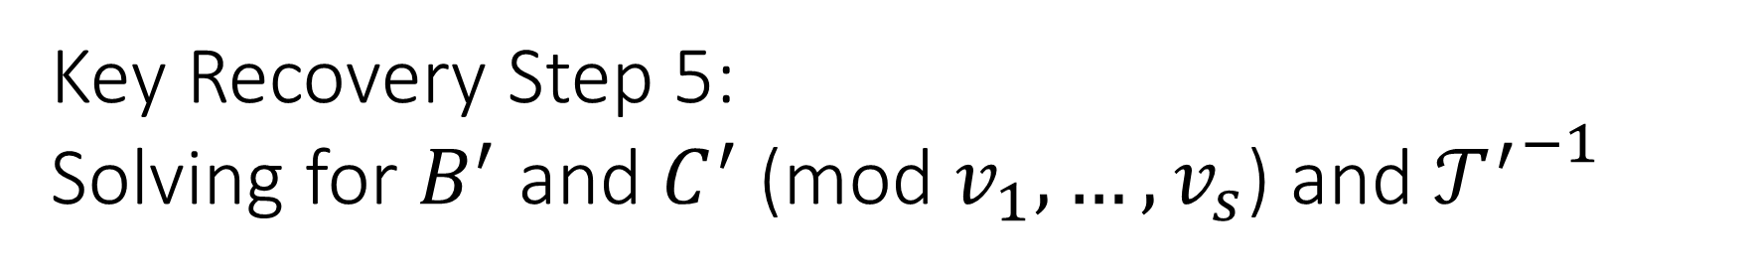
Key Recovery Step 5:
Solving for $B^{′}$ and $C^{′}$ $\text{(}\text{mod} v_{1},…,v_{s}\text{)}$ and ${𝒯^{′}}^{−1}$
We can solve linear equations for $B^{′}$, $C^{′}$, and ${𝒯^{′}}^{−1}$ (mod $v_{1},…,v_{s}$)
$$\left(A^{′}B^{′}, A^{′}C^{′}\right)={𝒯^{′}}^{−1}∘ℰ_{pub} \text{(}\text{mod} v_{1},…,v_{s}\text{)}$$
The solution $\text{(}\text{mod} v_{1},…,v_{s}\text{)}$ is (with high probability) unique up to column operations on $\left(B^{′}, C^{′}\right)$
  i.e. any solution will generate a valid private key.
Note that the coefficients of ${𝒯^{′}}^{−1}$ are scalars, not polynomials, so $\text{(}\text{mod} v_{1},…,v_{s}\text{)}$ does not affect ${𝒯^{′}}^{−1}$
  We now have our $𝒯^{′}$.

Slide 31
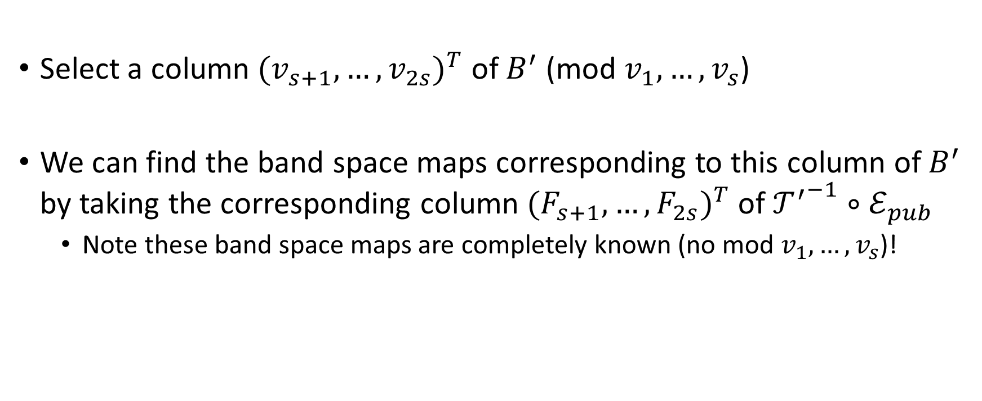
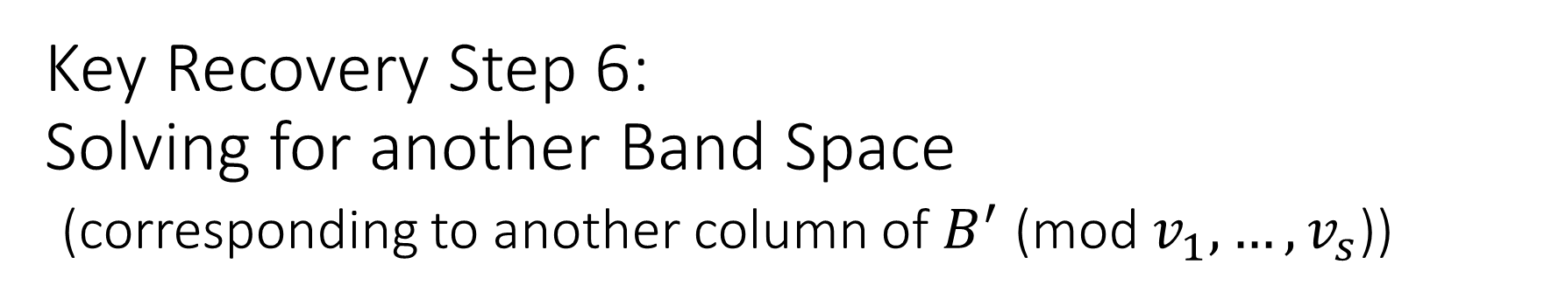
Key Recovery Step 6:
Solving for another Band Space
(corresponding to another column of $B^{′}$ (mod $v_{1},…,v_{s}$))
Select a column ${(v_{s+1},…,v_{2s})}^{T}$ of $B^{′}$ (mod $v_{1},…,v_{s}$)
We can find the band space maps corresponding to this column of $B^{′}$ by taking the corresponding column ${(F_{s+1},…,F_{2s})}^{T}$ of ${𝒯^{′}}^{−1}∘ℰ_{pub}$
  Note these band space maps are completely known (no mod $v_{1},…,v_{s}$)!

Slide 32
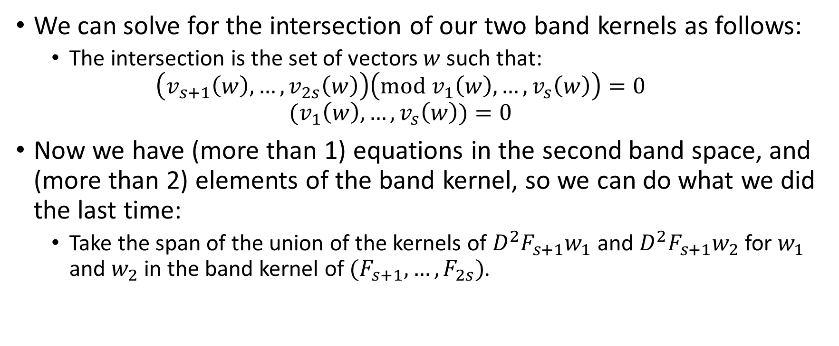
Key Recovery Step 7:
Solving for the Band Kernel
(For the Band Space we found in Step 6)
We can solve for the intersection of our two band kernels as follows:
  The intersection is the set of vectors $w$ such that:
  $$\left(v_{s+1}\left(w\right),…,v_{2s}\left(w\right)\right)\left(mod v_{1}\left(w\right),…,v_{s}\left(w\right)\right)=0$$
  $${(v}_{1}\left(w\right),…,v_{s}\left(w\right))=0$$
Now we have (more than 1) equations in the second band space, and (more than 2) elements of the band kernel, so we can do what we did the last time:
  Take the span of the union of the kernels of $D^{2}F_{s+1}w_{1}$ and $D^{2}F_{s+1}w_{2}$ for $w_{1}$ and $w_{2}$ in the band kernel of $(F_{s+1},…,F_{2s})$.

Slide 33
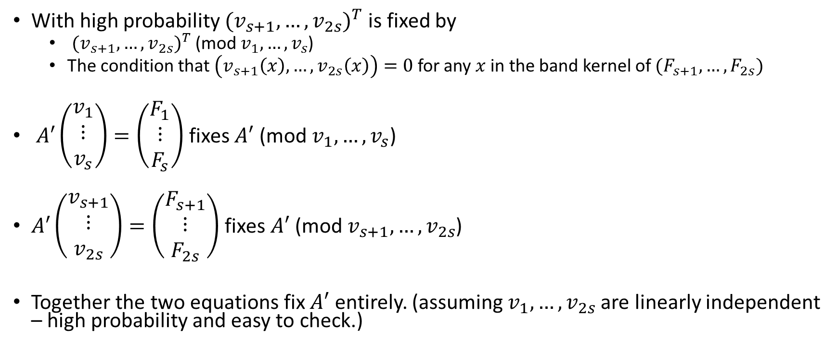

Key Recovery Step 8:
Solving for the Rest of $A’$
With high probability ${(v_{s+1},…,v_{2s})}^{T}$ is fixed by
  ${(v_{s+1},…,v_{2s})}^{T}$ (mod $v_{1},…,v_{s}$)
  The condition that$\left(v_{s+1}\left(x\right),…,v_{2s}\left(x\right)\right)=0$ for any $x$ in the band kernel of $(F_{s+1},…,F_{2s})$
$A′\left(\begin{matrix}v_{1} \\ ⋮ \\ v_{s}\end{matrix}\right)=\left(\begin{matrix}F_{1} \\ ⋮ \\ F_{s}\end{matrix}\right)$ fixes $A′$ (mod $v_{1},…,v_{s}$)
$A′\left(\begin{matrix}v_{s+1} \\ ⋮ \\ v_{2s}\end{matrix}\right)=\left(\begin{matrix}F_{s+1} \\ ⋮ \\ F_{2s}\end{matrix}\right)$ fixes $A′$ (mod $v_{s+1},…,v_{2s}$)
Together the two equations fix $A′$ entirely. (assuming $v_{1},…,v_{2s}$ are linearly independent – high probability and easy to check.)

Slide 34


Key Recovery Step 9:
Solving for the rest of $B′$ and $C′$
Same equation as before without the (mod $v_{1},…,v_{s}$)
$$\left(A^{′}B^{′}, A^{′}C^{′}\right)={𝒯^{′}}^{−1}∘ℰ_{pub}$$

